Slide 1




















HOSPITAL INFORMATION MANAGEMENT SYSTEM

Slide 2

INTRODUCTION
The Hospital Information Management System (HIMS) is a comprehensive solution designed
to streamline the administrative, clinical, and financial operations of a hospital,addressing the increasing demands and evolving expectations in healthcare.
Efficient hospital management is crucial as it ensures optimal resource utilization, minimizes operational costs, And enhances the quality of patient care by reducing administrative
burdens on healthcare providers.
Additionally, a robust HIMS improves data management and security, ensuring accurate and secure storage of sensitive patient information in compliance with healthcare regulations.
It also facilitates better decision-making through comprehensive data analysis and reporting, enabling informed administrative decisions.

Slide 3


DATABASE TABLES
Access Rights
Admission
Advance
Application Functionality
Bed
Bill
Charge
City
Clinical Note
Country
Department
Discharge
Doctor
Gender
Insurance Company

Slide 4

DATABASE TABLES
Nationality
Patient
Patient Category
Prescription
Relation
Room
Service
Service Category
Service Type
Staff
State
Unit
Users
Visit
Ward

Slide 5

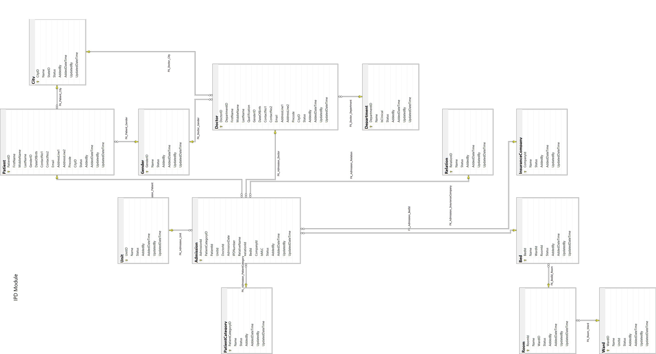


DATABASE DIAGRAM
IN PATIENT DEPARTMENT

Slide 6

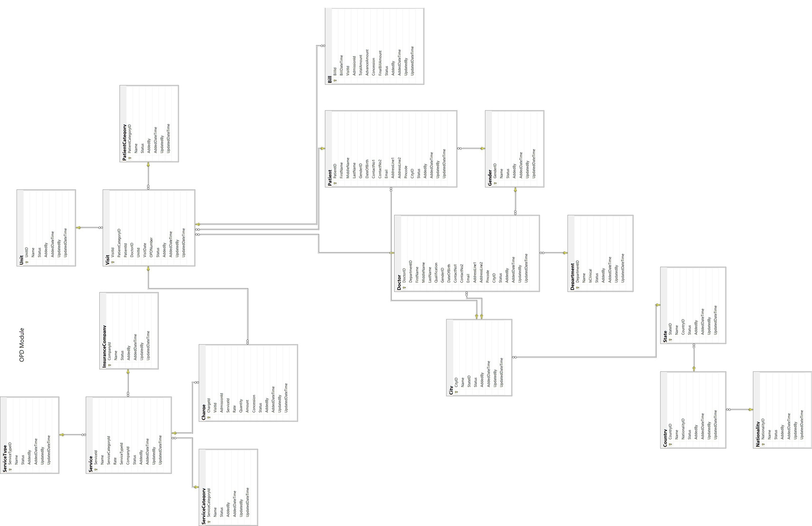
DATABASE DIAGRAM
OUT PATIENT DEPARTMENT

Slide 7
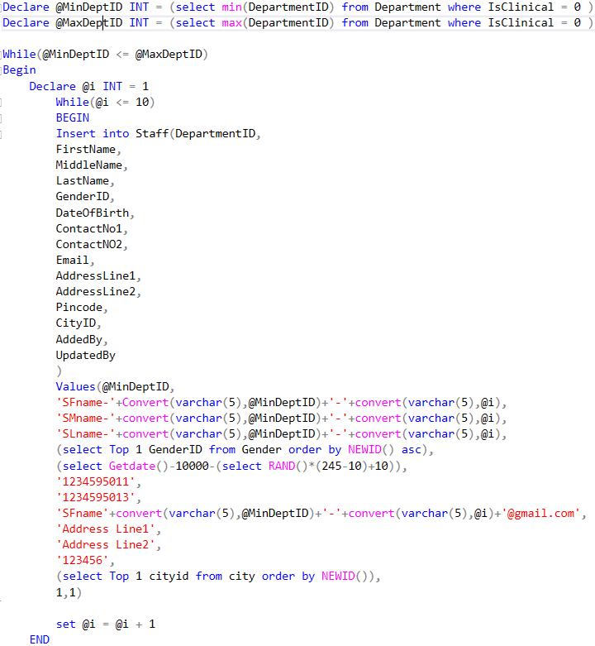
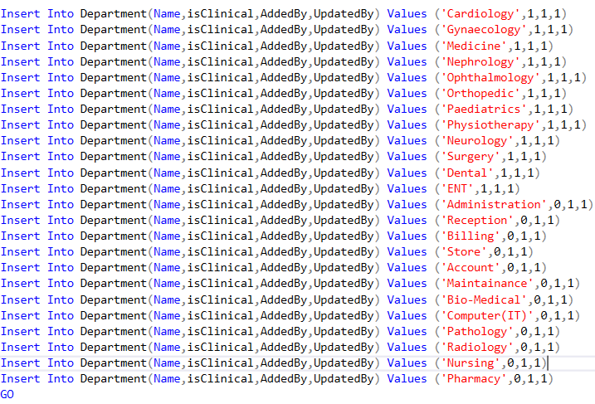

DUMMY DATA INSERTION SNIPPETS

Slide 8
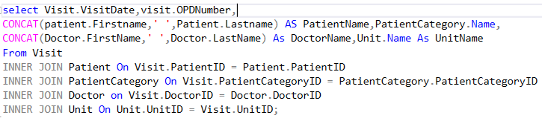

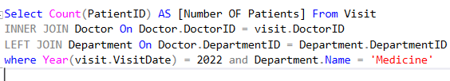
QUERIES
Q1. Patients details who visited to hospital and their corresponding doctors ?
Q2. Number of patients visited to medicine department in 2022 ?

Slide 9

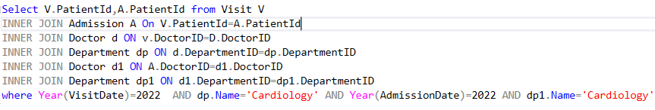


QUERIES
Q3. Patients who are visited and Admitted at Cardiology Department
Q4. Patients details based on their diagnosis departments ?

Slide 10
THANK YOU VERY MUCH!

